Slide 1
日韓比較労使関係論 ３
日本の労使関係
雇用調整の歴史的経過を中心に

Slide 2
Formation of Employment Adjustment System and Japanese Society
Japanese Society = Stable
  True, but !
  We need to answer to question “How it can be possible? How it can be stable?”
  The answer is Japanese society has a dynamics inside as a precondition to be stable.
Japanese Employment System
  Seniority, Company-union and Lifetime-employment
  →“A Stable system”
My thought
  “Stable” employment system in Japan
  →It was formed after paid cost of “employment adjustment”

Slide 3
Employment Adjustment
in Three Big Restructuring Periods

Slide 4
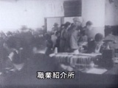
The Great Depression
Policy
  Industrial Rationalization Policy
  Rationalization for Equipments, but
  No have measures for retirees
  No Trade Union Law
  Workers have no rights of objection or participation in decision process
Company
  Workers’ Rights
  Didn’t recognize negotiation
  Retire Allowance
  Pay to lead a retirement

Slide 5
Employment Adjustment at Manufacturing and Mining Industry
Reconstruction
Industry | Company | Term | Number of Retirement |  | Company | Term | Number of Retirement
Steel | Daidō Steel | 1949.3 | 3,000 |  | Nippon Steel | 1949.6 | 2,350
 | Fusō Metal | 1949.6 | 2,350 |  | Nagasaki Iron | 1950.8 | 369
Machinery | Mitsui Precision | 1949.2 | 650 |  | Minsei Diesel | 1949.10 | 1,000
 | Nippon Light Metal | 1949.5 | 724 |  | Hitachi Factory | 1950.5 | 5,555
 | Mitsubishi Heavy Industry | 1949.6 | 2,000 |  | Fuji Manufacturing | 1950.9 | 520
Electric machine | Oki Electric | 1949.4 | 2,800 |  | Toshiba Electric | 1949.7 | 4,581
 | Nippon Electric | 1949.4 | 3,569 |  | Fuji Communication | 1949.7 | 1,490
 | Mitsubishi Electric & Machine | 1949.5 | 1,700 |  | Nippon Communication Manufacturing | 1949.8 | 300
Electric wire | Nippon Wireless | 1948.11-1 | 379 |  | Furukawa Electric | 1949.7 | 1,400
 |  | 1949.8 | 184 |  |  | 1950.4 | 950
 |  |  |  |  | Tōnichi Wireless | 1950.5 | 235
Chemicals | Sankyō Medicine | 1949.2 | 300 |  | Shōwa Electric | 1949.11 | 2,868
 | Nippon Cement | 1949.5 | 1,314 |  | Nippon Soda | 1950.3 | 930
 | Tōyō Synthetic | 1949.5 | 659 |  | Mitsui Chemical | 1950.3 | 1,540
 | Wakamoto | 1949.5 | 337
Automobile | Isuzu | 1949.9 | 1,279 |  | Toyota | 1950.5 | 1,600
 | Nissan | 1949.10 | 2,000
Vehicle | Steam Locomotive | 1949.5 | 1,521 |  | Teikoku Vehicle | 1949.7 | 403
 | Kawasaki Vehicle | 1949.5 | 1,700 |  | Nippon Vehicle | 1949.9 | 360
 | Tōshia Vehicle | 1949.7 | 580 |  | Hitachi | 1950.5 | 850
 | Kinki Vehicle | 1949.7 | 620 |  | Niigata Iron | 1950.7 | 660
Shipbuilding | Hakodate Dock | 1949.9 | 205 |  | Kawasaki Heavy Industry | 1949.9 | 1,200
 |  | 1950.7-9 | 966 |  | Tamano Shipbuilding | 1949.10 | 32
Mining | Furukawa Mining | 1950.7 | 482

Slide 6
Retirement Rate by Employment Adjustment during Reconstruction Period
Company | Total | Retirement | Voluntary retirement
Oki Electric | 6,700 | 2,800 (41.8) | 2,035 (72.7)
Nippon Electric | 10,271 | 3,569 (34.8) | 1,700 (47.6)
Toshiba Electric | 22,207 | 4,581 (20.6) | 3,207 (70.0)
Mitsubishi Electric and Machine | 17,800 | 1,700 ( 9.6) | N.A.
Daidō Steel | 9,700 | 3,000 (30.9) | N.A.
Nippon Cement | 6,400 | 1,314 (20.5) | N.A.
Wakamoto | 832 | 337 (40.5) | N.A.
Range of Adjustment
  All of Manufacturing Industries like steel, machinery, electric machine & wire, chemicals, automobile, vehicle, shipbuilding and Mining Industry
Retirement Rate
  Not so low & Voluntary retirement rate is so high

Slide 7
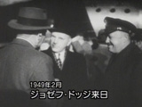
Policy
  Strong Deflation Policy(Dodgy Line)
  Enterprise Reconstruction Policy
  Have specific measures for retirees
  Trade Union Law
  Enacted 1945.12.
Company
  Workers’ Rights
  Recognize late of 1940s through paid cost of employment adjustment process
  Retire Allowance
  Pay to lead a retirement

Slide 8
Applied Rate by Volunteer Retirement during Oil Shock Period
Oil Shock
 | Company Name | Total Employee | Application Number | Applied Number | Applied Rate | Retire Rate
Shipbuilding | Hitachi | 22,396 |  | 1,850 |  | 8.3
 | Sumitomo | 10,412 | 1,200
 | Mitsui |  |  | 756
 | Sasebo | 6,677 | 850 | 1,681 | 197.8 | 25.2
 | Hakotate | 3,304 | 300 | 119 | 39.7 | 3.6
 | Nimura | 2,338 | 390 | 590 | 151.3 | 25.2
 | Sanoyasu | 1,933 | 426 | 136 | 31.9 | 7.0
 | Kasado | 1,784 | 300 | 469 | 156.3 | 26.3
 | Oosaka | 1,079 | 350 | 330 | 94.3 | 30.6
 | Nihonnkai | 915 | 200 | 220 | 110.0 | 24.0
 | Usuki |  | 550 | 419 | 76.2
 | Kanasashi |  | 350 | 553 | 158.0
Steel | Nippon Stainless | 1,670 | 390 | 377 | 96.7 | 22.6
 | Kobe Chutetsu | 1,200 | 481 | 326 | 67.8 | 27.2
 | Shinkokosen | 1,170 | 481 | 219 | 45.5 | 18.7
 | Daidoukohan | 783 | 147 | 151 | 102.7 | 19.3
 | Daiwaseiko | 529 | 251 | 238 | 94.8 | 45.0
 | Ootetsu | 540 | 140 | 114 | 81.4 | 21.1
 | Yasakuseitetsu | 490 | 150 | 175 | 116.7 | 35.7
 | Tetsukatenoru |  | 361 | 467 | 129.4
 | Nittetsukinzoku |  | 339 | 231 | 68.1
 | Amagasakiseitetsu |  | 100 | 100 | 100.0
 | Nihonkomu |  | 65 | 86 | 132.3
Chemicals | Shimura |  | 259 | 63 | 24.3
 | Honshu |  | 200 | 51 | 25.5
 | Sakai |  | 170 | 80 | 47.1
 | Rin |  | 150 | 118 | 78.7
Electricity | Oki |  | 1,500 | 1,064 | 70.9
 | Yasukawa |  | 750 | 385 | 51.3
Textile | Mitsubishi rayon |  | 900 | 1,000 | 111.1
Mining | Mitsui |  | 365 | 475 | 130.1
Range of Adjustment
  Many of shaped industries like shipbuilding, steel, chemicals, electricity, textile and mining
Applied Rate
  Not so low

Slide 9

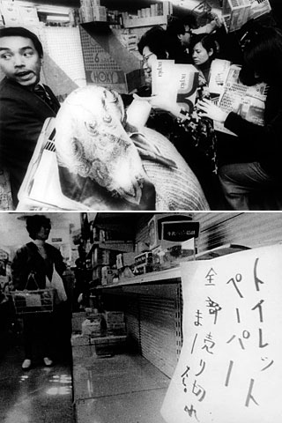
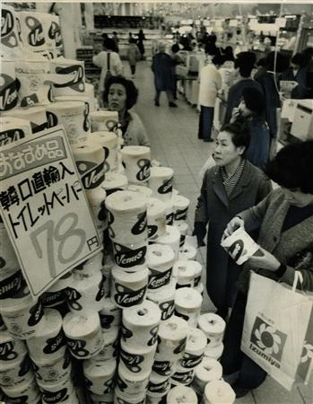
Policy
  Fading Industry Policy
  Apply from coal & textile to all of fading industries like shipbuilding, chemical textile, and chemical fertilizer
  Tripartite Negotiation
  Trade union and Employers participate in policy’s decision making process
Company
  Workers’ Rights
  Routinized negotiation with employer and employees before employment adjustment process
  Retire Allowance
  Pay to lead a retirement

Slide 10
Increasing of Irregular Workers in Shipbuilding Industry

Slide 11
Employment Adjustment System in Japan
Myth of Lifetime Employment
  ‘Lifetime Employment’
  →Symbol of stable Japanese employment system
  But,
  “only during high economic growth period 1950s-the half of 1970s”
  → And
  contains dynamics of adjustment as a precondition
Related to Japanese Society
  Contains dynamics as a precondition of its own

